Slide 1
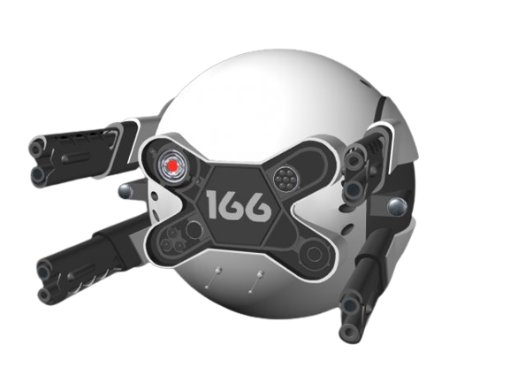
“SOMEBODY IS WATCHING YOU”
PROJECT AI PREDATOR

Slide 2
MOTIVATION
HUMAN LIFE IS CONSIDERED AS THE MOST PRECIOUS LIFE ON EARTH.
INDIAN ARMY LOST 1 SOLDIER ONDUTY IN EVERY 3 DAYS FROM LAST 13 YEARS.

Slide 3
CEASE FIRE VIOLATION IS CONSIDERED AS THE MAJOR PART OF CASUALTIES EVERY YEAR .
AROUND 2500 ARMY PERSONELLS LOST THEIR LIVES EVERY YEAR DUE TO CEASEFIRE.
AN ARMY IS TRAINED TO FIGHT WITH COMBAT SITUATIONS , AND NOT FOR UPCOMING RANDOM BULLET FROM BORDER SIDE.
MANY LIVES ARE LOST NOT ON COMBAT WITHOUT ACTUAL 1-1 FIGHTING SCENARIO.

Slide 4
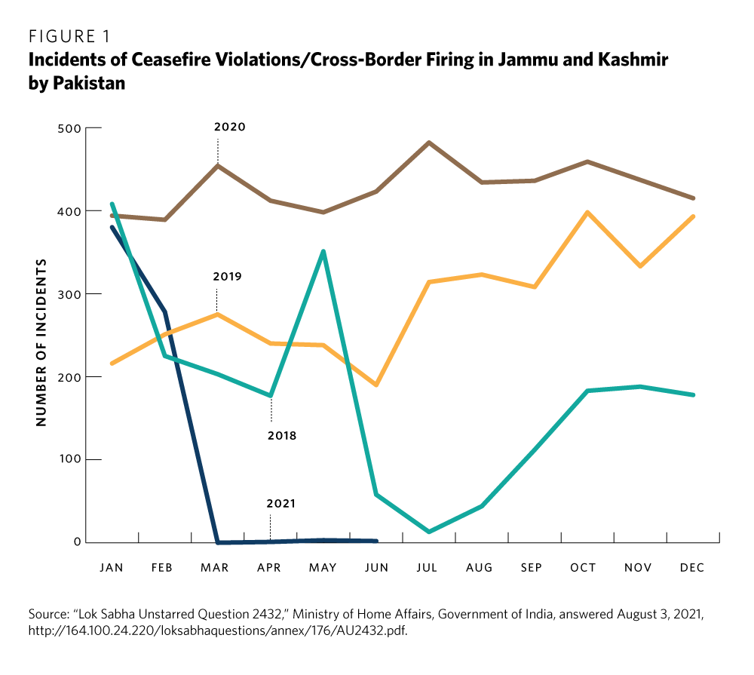

Slide 5
PROJECT PURPOSES
TODAY’S ERA IS ERA OF ARTIFICIAL INTELLIGENCE AND MACHINE LEARNING.
WE HUMANS HAVE EMOTIONS AND THERE IS A CHANCE OF ERROR.
AS MACHINES HAVE NO EMOTIONS THERE IS AN ADVANTAGE OF NO LOSS OF LIFE IF DAMAGED.
AN LEARNING MACHINE CAN RESOLVES ALL THE HUMAN LIMITATIONS AND THUS INCREASE OUR CHANCE OF WINNING.

Slide 6
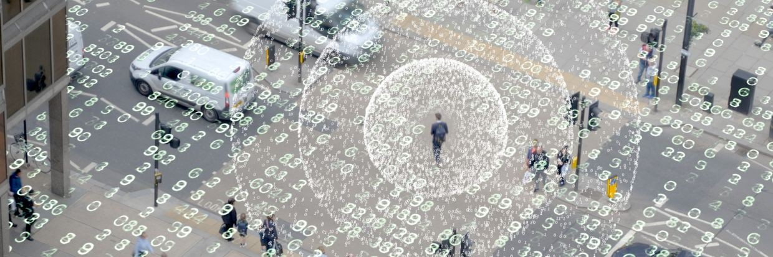
PROJECT PROMISES
SURVILLANCE:

Slide 7
IT’S SMART SURVILLENCE SYSTEM MONITORS ALL THE ACTIVITIES IN REAL TIME
IT PROVIDES THREAT’S ALERT SYTEM TO PREVENT ANY UNUSAL HAPPENING.
IT CAN TRACK MULTIPLES THREAT AT SAME TIME.
IT ACTS AS A “SLEEPER CELL” WHEN ONLY MONITORING IS REQUIRED
IT WILL HIT THE TARGET WHEN IT IS IN ITS PERIMETER .
IT LEARNS FROM ITS PREVIOUS THREATS.

Slide 8
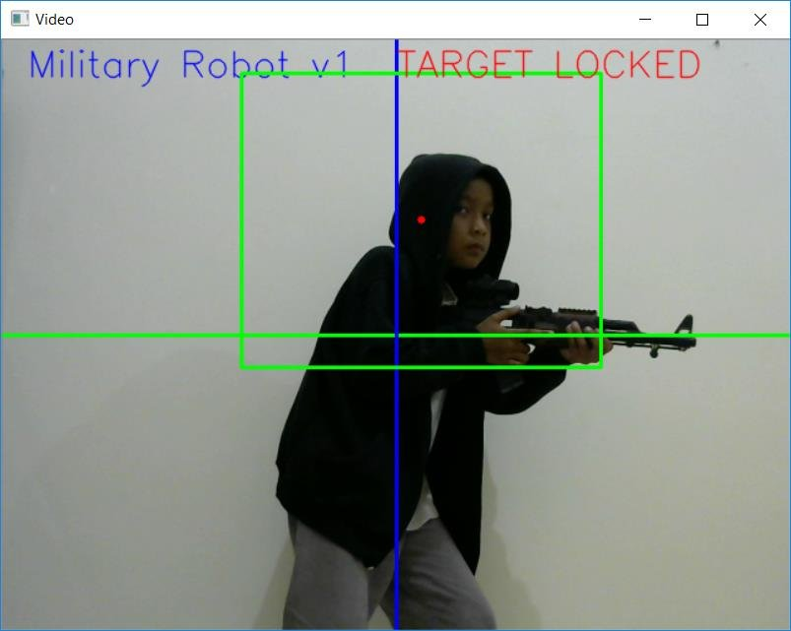
MACHINE LEARNING

Slide 9
IT CAN DETECTS THREATS FROM ITS BEST ALGORITHMS EXIST IN THIS WORLD.
IT LEARNS THE PATTERN OF THREATS AND ANALYSES FROM ITS PREVIOUS THREATS.
BEST ALGORITHMS REDUCED EROOR OF PRECISION .
CALCULATED DATA IS USED AND BASED ON THAT DECISION IS TAKEN AUTOMATICALLY.
NO HUMAN ERROR IS INVOLVEMENT.

Slide 10
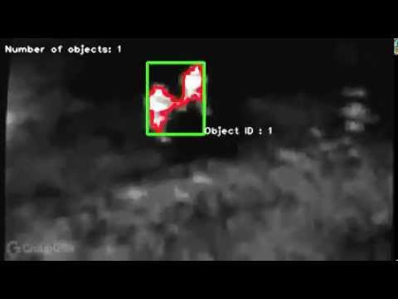
ROBUSTNESS

Slide 11
IT CAN WORK ON ANY TERRAIN OR REMOTE AREAS
IT CAN BE TRUSTWORTHY IN MOST OF WEATHER CONDITIONS.
IT’S NIGHT VISION AND THERMAL CAMERA HELPS IT TO DETECT INTRUDERS AT NIGHT ALSO.
IT’S HARDWARE CAN EASILY BE REPLACEABLE SO WE HAVE TO JUST PLUG AND PLAY.

Slide 12
PRECISION & ACCURACY
“Learning from your past makes you more accurate”.
IT CAN LEARN FROM IT’S PAST AND IMPROVE ITSELF.
IT’S BUILT IN ALGORITHM HELPS IT TO IMPROVES ITS GOOD AND BAD CASES.
SELF – IMPROVEMENT IS A KEY TO THE UPCOMING TECHNLOGIES.

Slide 13
UNIQUENESS OF PROJECT:

Slide 14
MACHINE LEARNING ALGORITHMS
MACHINE LEARNING ALGORITHMS HAVE HIGH PRECISION THAN HUMAN ERRORS.
IT HELPS MACHINE TO LOGICALLY SOLVE ANY REAL LIFE PROBLEM.
A MACHINE WITH BRAIN CAN BEAT HUMAN EFFICIENCY.
THESE ALGORITHMS BASED ON COMPLEX MATHEMATICAL AND STATICAL DATA THEOREMS

Slide 15
ADVANCE THREAT DETECTION SYSTEM
ADVANCE THREAT DETECTION SYSTEM ALLOWS IT TO PROCESS DIFFERENT VARITIES OF THREATS.
MULTIPLE THREATS CAN BE ANALYSED IN REAL TIME
IT CAN UPDATE NEW SIGNATURES OF THREATS TIME TO TIME
WE CAN SIMULATE REAL LIFE SCENARIO IN VIRTUAL FORM

Slide 16
SMART UPGRADATION
HARDWARE UPGRADATION IS NOT REQUIRED TIME TO TIME FOR DIFFERENT PURPOSES
WE CAN CHANGE THE REQUIREMENT BY JUST CHANGING PROGRAMMING CODES.
ON CHANGING ALGORITHMS WE CAN CHANGE PURPOSE OF SYSTEM.
IT CAN BE USED FOR MULTIPURPOSES PROJECTS(i.e only survillance or threat detection).

Slide 17
PREDATOR PATTERN
IT FOLLOWS PREDATOR PATTERN IT MEANS IT CAN FIRST MONITOR THE THREAT AFTER WHEN INTRUDER IS AT THE PERIMETER.
IT ENHANCE THE PREDATOR ABILITIES WITH DIFFERENT ACCURATE PREDICTIONS.
PREDATOR SYSTEM CAN BE UPGRADED TIME TO TIME BASED ON PREVIOUS RESULTS.
WE CAN ALSO SET DIFFERENT MODELS OF PREDATOR SYSTEM ON IT.

Slide 18
SAVIOUR
“When a machine saves a life it’s not less than a boon”.
This projects main objective is to save army casualties by cease fire violation.
Modern war will take places of machines.so its better to save human life using machine.
Using Ai machines leads to alert in potential threat that could further destruct human being.

Slide 19
“THIS PROJECT IS DEDICATED TO ALL THE BRAVEST SONS & DAUGHTER OF OUR MOTHERLAND WHO GAVE THEIR LIVES , SO THAT WE WILL FEEL SECURE AT OUR HOMES.”
“THIS PROJECT IS ALSO DEDICATED TO UPCOMING DEFENSE SCIENTIST WHO INNOVATE BETTER TECHNOLOGIES TO REDUCE ARMY LIFE LOSS”

Slide 20

JAI HIND

